Slide 1
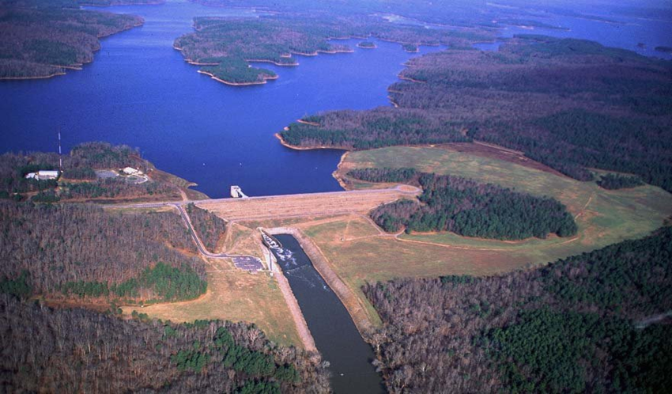
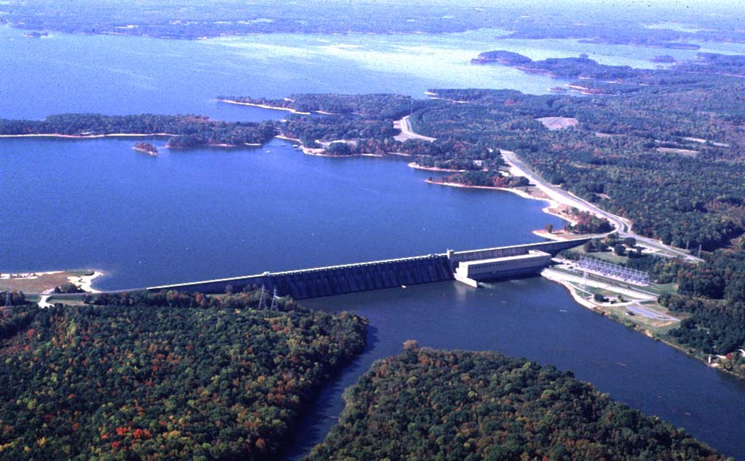
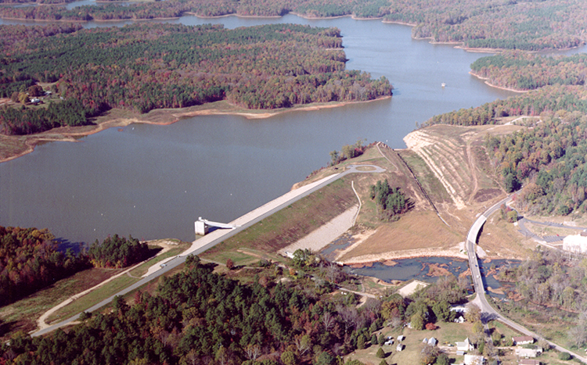
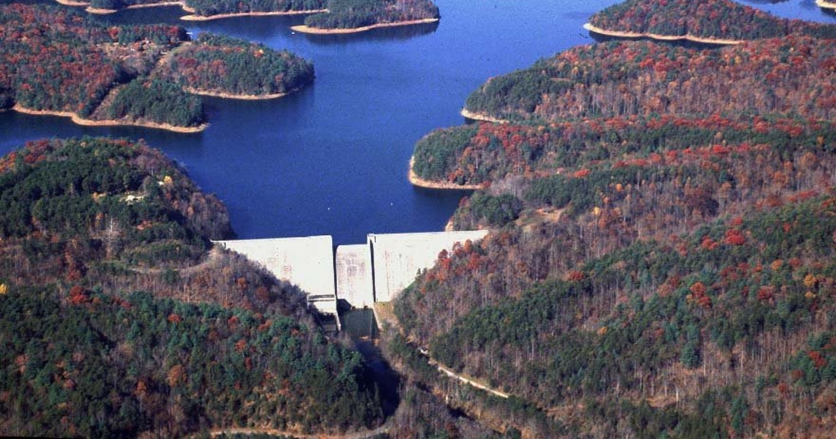
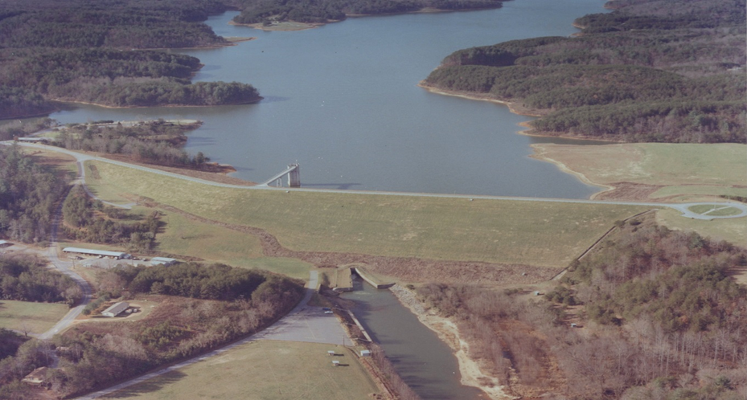
Wilmington district Reservoir operations
Michael A (Tony) Young, P.E.
Water Management Chief
Wilmington District
Date: 08 May 2019
Jordan
Kerr
Falls
Philpott
Scott

Slide 2
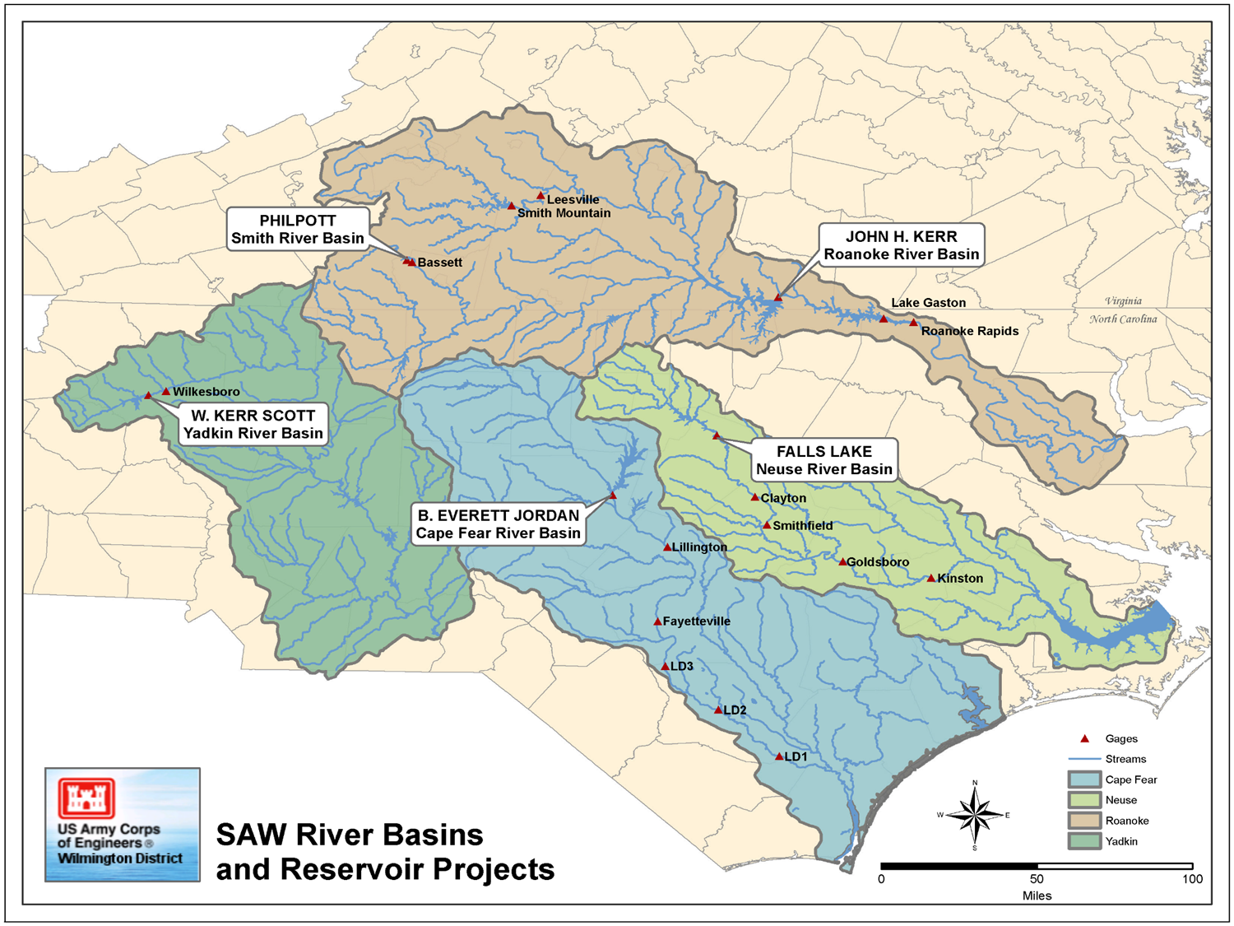
Example slides

Slide 3
Water Management Goals
Maximize congressionally authorized purposes within existing operational guidelines
Predictable responses to varying conditions
Actively inform affected stakeholders
Flood Control
Hydropower
Water Supply
Water Quality & Low Flow Augmentation
Recreation
Fish & Wildlife Enhancement

Slide 4
Water Management Goals
Maximize congressionally authorized purposes within existing operational guidelines
Predictable responses to varying conditions
Actively inform affected stakeholders
Specific Water Control Plans for each Project
Flood Operations
Drought Contingency Plans
Deviations

Slide 5
Water Management Goals
Maximize congressionally authorized purposes within existing operational guidelines
Predictable responses to varying conditions
Actively inform affected stakeholders
Weekly status report & call
Face-to-face meetings
Positive, routine interaction
“Door to the Corps” for many stakeholders

Slide 6
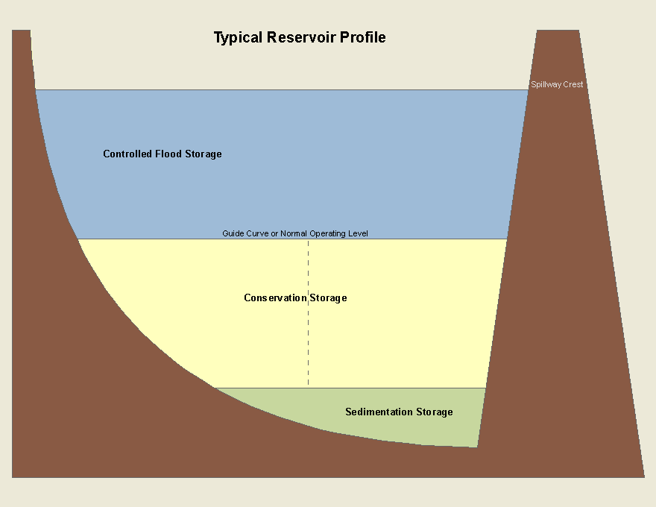
Example slides
Typical Reservoir Profile
Controlled Flood Storage
Guide Curve (Normal Operating Level)
Conservation Storage
(Water Supply, Water Quality, Power)
Each storage pool tracked separately
Sedimentation Storage

Slide 7
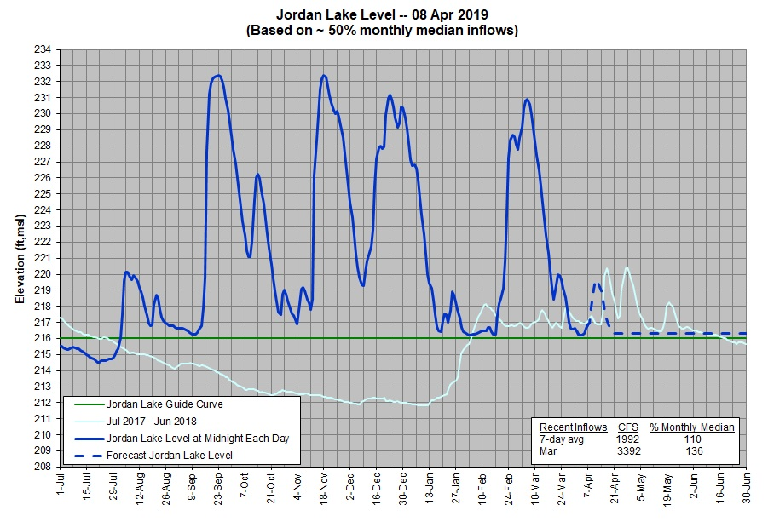
Example slides
Guide Curve (Constant)

Slide 8
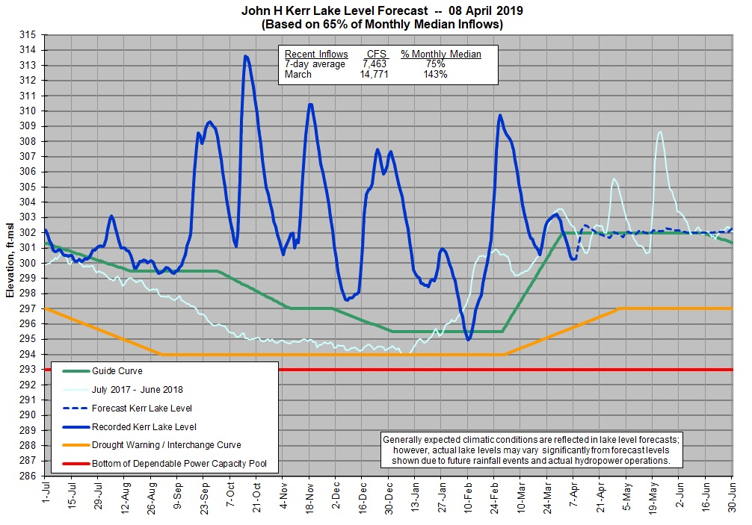
Example slides
Guide Curve (Varying)

Slide 9
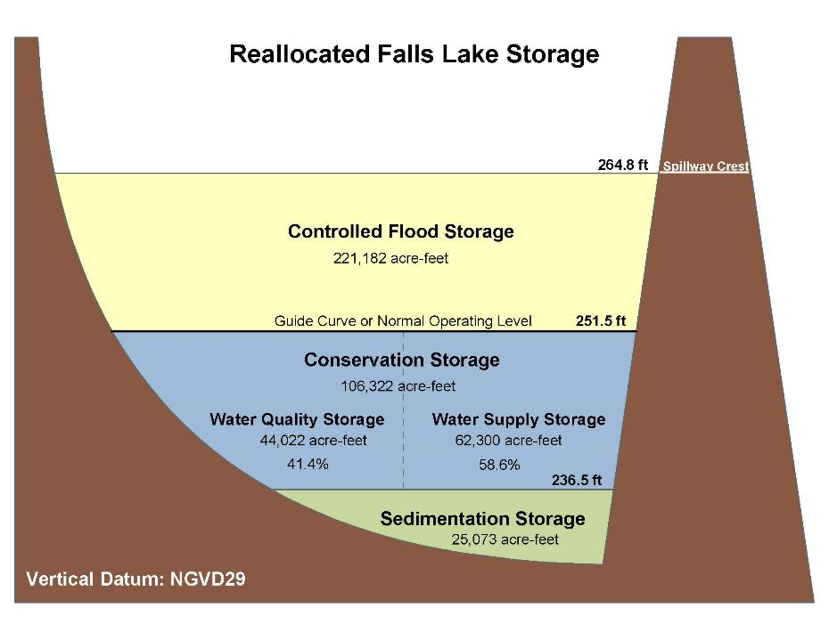
Example slides
Guide Curve (Varying)

Slide 10
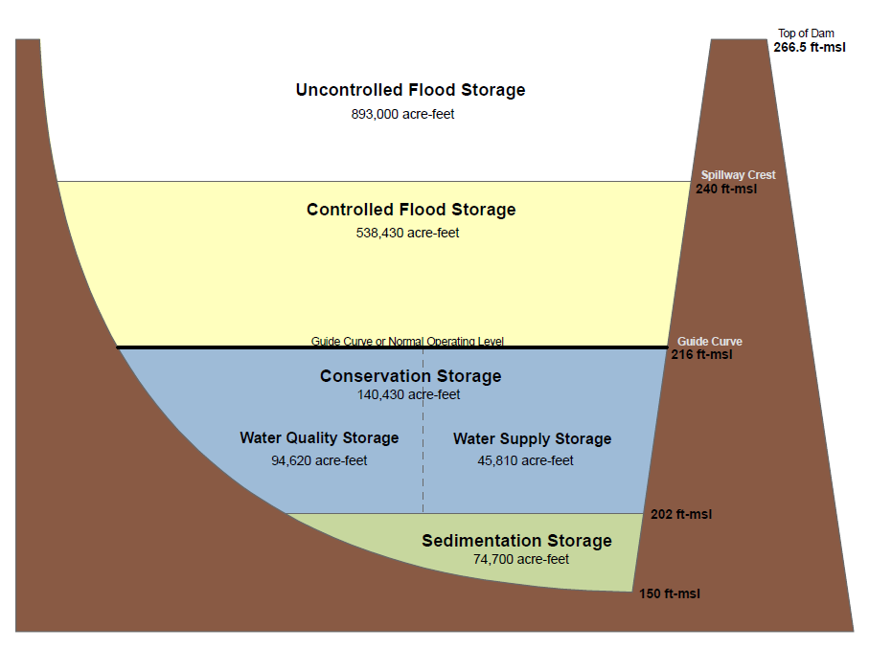
B. Everett Jordan Dam and Lake
32.6%
67.4%

Slide 11
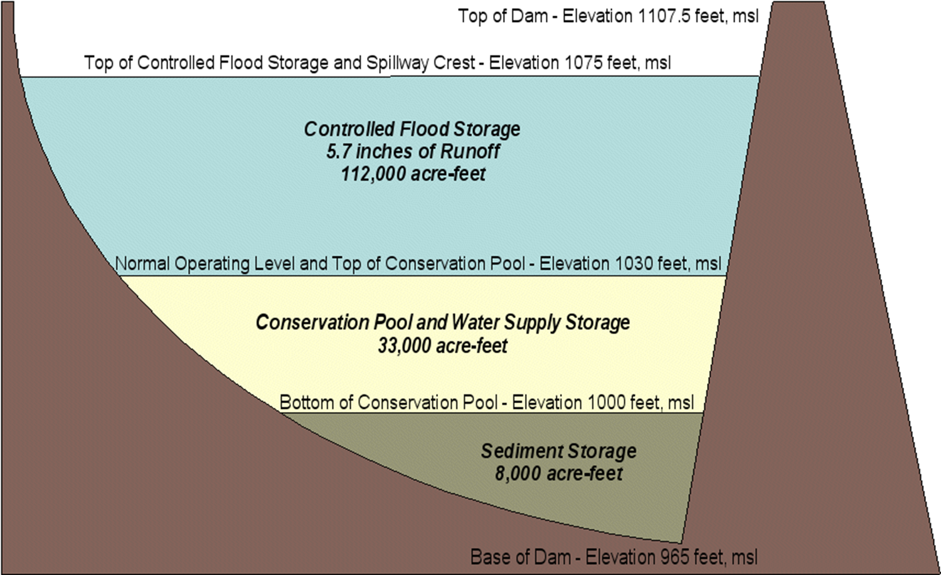
Example slides
W Kerr Scott

Slide 12
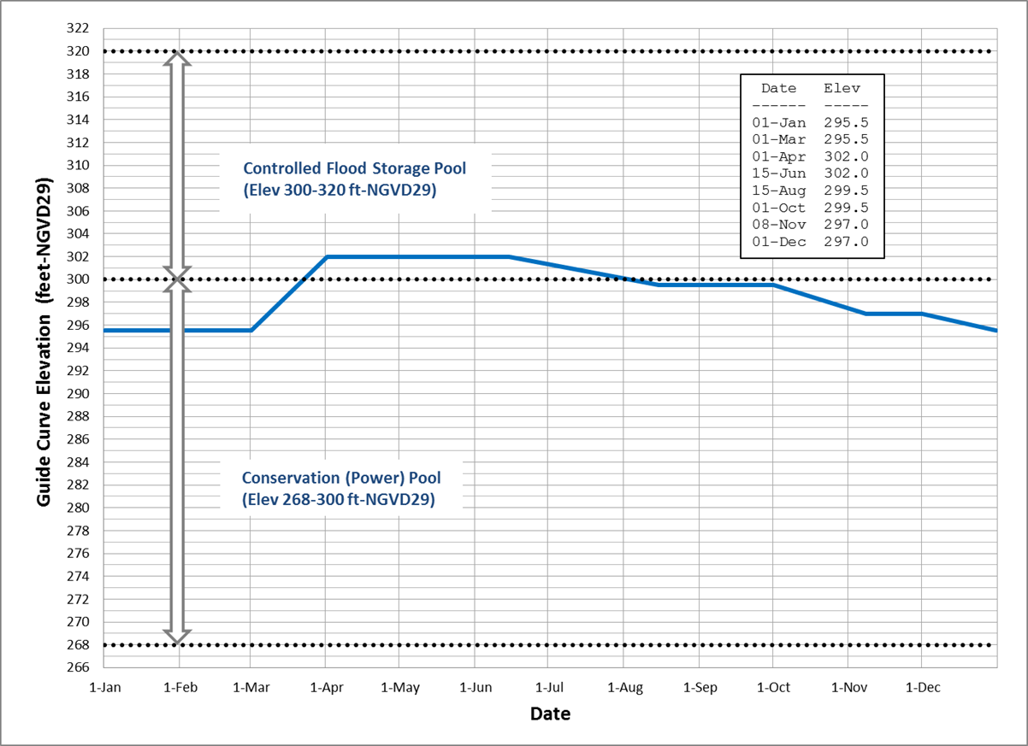
Example slides
John H Kerr

Slide 13
Flood Operations
Temporary storage of floodwaters for release at controlled, non-damaging or less-damaging rates
Releases based on water-on-the ground…not forecasts (no pre-releases)
WCP establishes release protocols (control pts, stage/release limits, etc)
Jordan -- Fayetteville primary flood control point
Falls -- Clayton primary FC point, but consideration of farther downstream (Goldsboro/Kinston)
Scott – Wilkesboro primary FC point
Kerr – Recently changed; weekly releases ≈ previous week’s inflows (up to 35,000 cfs)

Slide 14
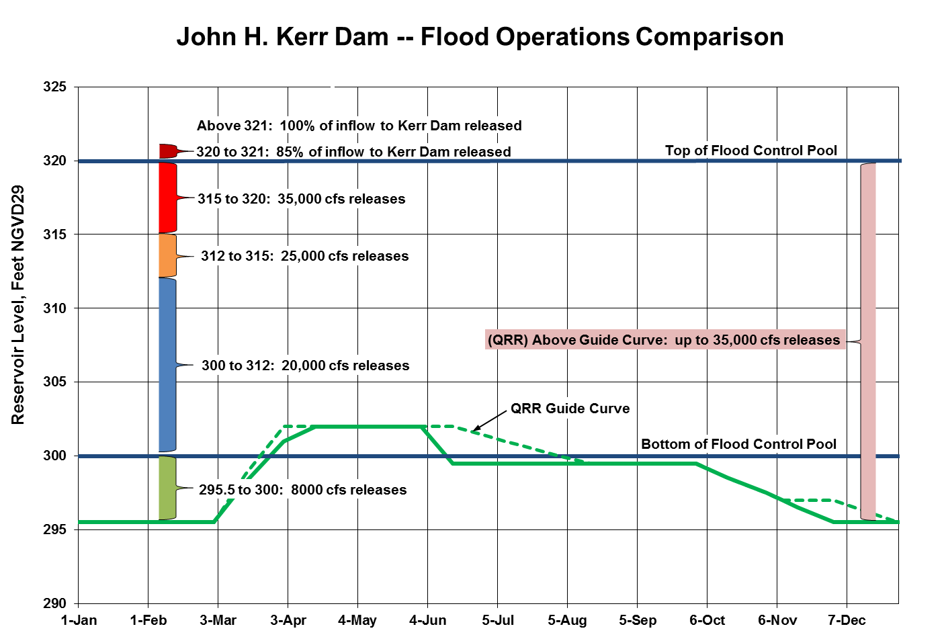
Example slides
Guide Curve (Varying)

Slide 15
Water Quality & Low-Flow Augmentation
Releases to meet minimum downstream flow targets during low flows
Drought Contingency Plans to conserve WQ storage
Jordan (WQ 67.4% of conservation pool)
600+/-50 cfs minimum flow target at Lillington (~24 miles downstream)
Reduced target when WQ storage drops below 80% (very proactive)
Falls (WQ 41.4% of conservation pool)
Immediately below dam (100 cfs Apr-Oct; ~60 cfs Nov-Mar)
Downstream (~33 miles) at Clayton (254 cfs Apr-Oct; 184 cfs Nov-Mar)
Scott (No WQ storage)
400 cfs minimum flow target at Wilkesboro (5.5 miles downstream).
Reduced flow target when lake is more than a foot below guide curve
Kerr (No WQ storage)
Minimum energy meets downstream minimum flow requirements

Slide 16
Water Supply
Jordan
WS storage: 45,800 AF (32.6% of conservation pool)
Estimated yield ~100 MGD
100% allocated to State of NC
95.9% of WS storage “reallocated” by State of NC
Falls
WS storage: 62,300 AF (58.6% of conservation pool) (previously 45,000 AF)
Estimated yield ~84 MGD (previously ~69 MGD)
100% allocated to City of Raleigh
Scott
WS storage: 33,000 AF (100% of conservation pool)
100% allocated jointly to City of Winston-Salem and Wilkes County
Water released as requested/needed for W-S (min releases adequate so far)
Wilkesboro/N Wilkesboro pursuing reservoir intake using County’s storage
Detailed yield analysis needed (perhaps as much as 150 MGD)

Slide 17
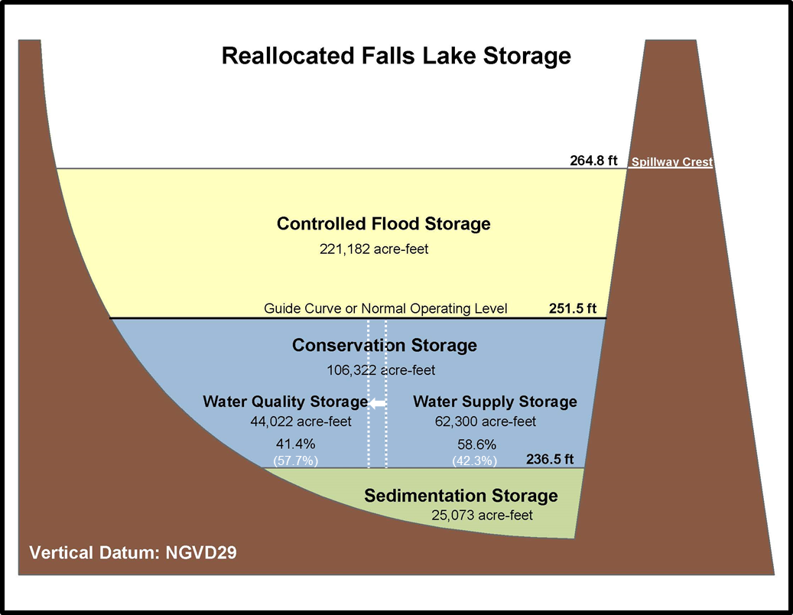
Example slides
Guide Curve (Varying)

Slide 18
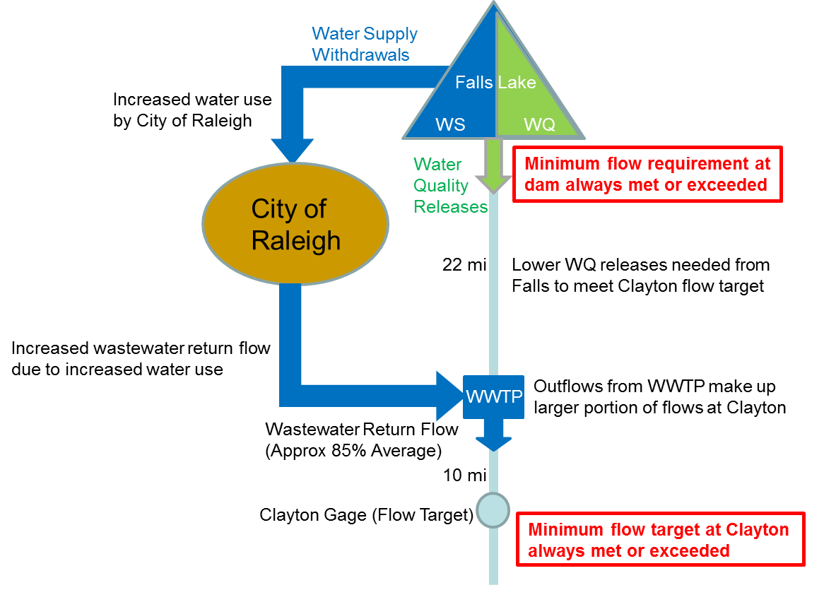
Falls Storage Reallocation – Why it Worked

Slide 19
John H Kerr Water Supply allocations
All Water Supply storage reallocated from Power Pool
Water User | Agreement Type | Storage acre-feet (% of PP) | Date of Agreement
Virginia Beach, VA | Water Storage | 10,200 AF (1.055%) | 13-Jan-84
Henderson, NC | Water Storage | 10,292 AF (1.066%) | 17-Mar-06
VA Dept of Corrections | Water Storage | 23 AF (0.0024%) | 07-Apr-89
Mecklenburg Cogen (Dominion) | Water Storage | 600 AF (0.063%) | 20-Jun-91
TOTAL | Water Storage | 21,115 (2.186%)
Clarksville, VA | Grandfathered | 0.3 MGD avg | No Agreement
Burlington Industries | Grandfathered | 2.2 MGD avg | No Agreement

